Slide 1

Date : 26.03.2018
A presentation of :
QUANTUM THEORY
By: Mohammad Zulfiqar WARDI [zul]
What are the differences between...
Answer
Quantum theory?..
or Quantum mechanics?..
or Quantum physics?
They’re all the same!

Slide 2

Overview
1. A brief history of quantum physics
i. Origin (Max Planck)
ii. Thought experiment (Schrödinger)
2. Quantum physics explained
i. Dual slit experiment (Thomas Young)
ii. Superposition
3. Real world application
4. Conclusion
i. Opinions
ii. Thoughts
5. BONUS SECTION!
Questions

Slide 3
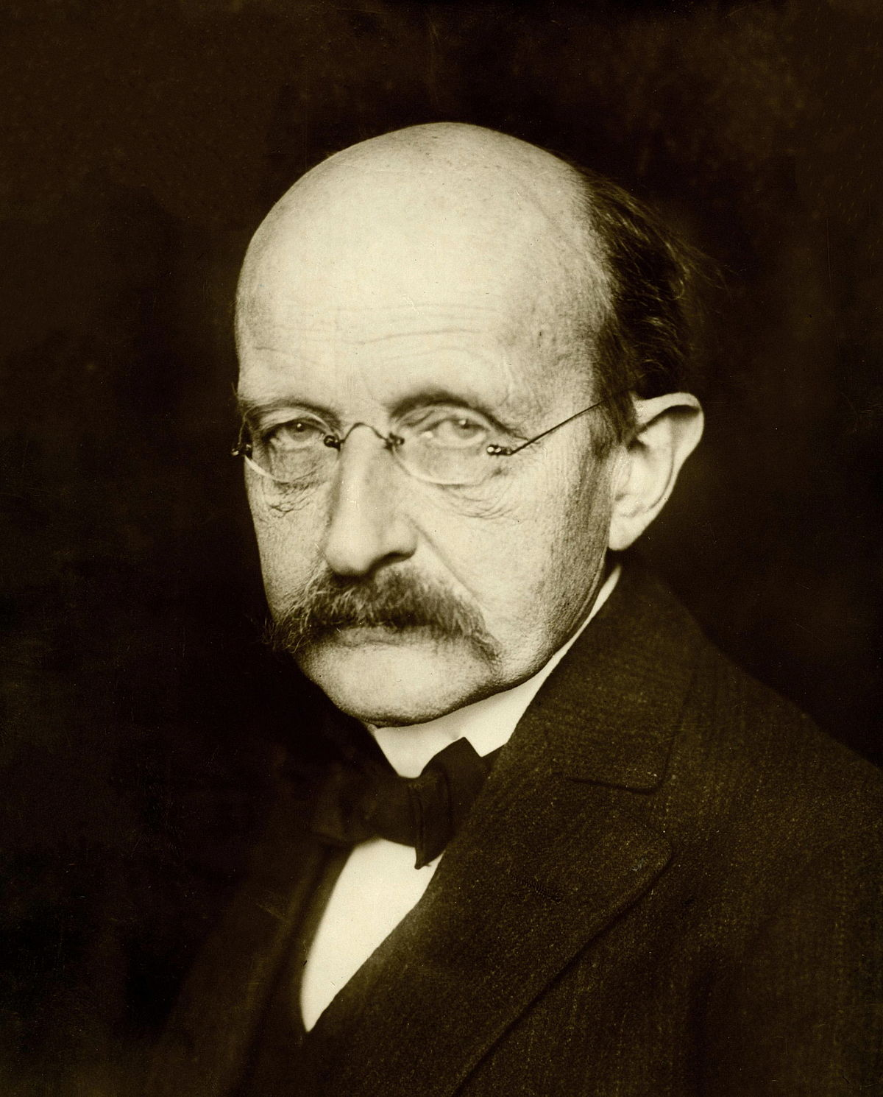
Origin : Etymology and discovery
Etymology
“quantus” → Quanta of electricity → Quanta →Quantum
i. German theoretical physicist
ii. Nobel Prize in Physics in 1918
iii. Max Planck Society
Max Karl Ernst Ludwig Planck
1947 -1858

Slide 4
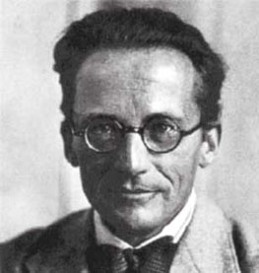
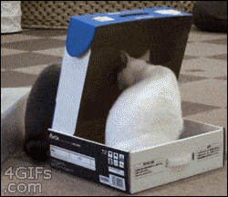
Erwin Rudolf Josef Alexander Schrödinger
i. Austrian physicist
ii. Author of many works:
- statistical mechanics,
- thermodynamics,
- colour theory,
- electrodynamics,
- cosmology
Etc..
1887 - 1961
iii. “the cat in the box” thought experiment
iv. abandoned the theory

Slide 5
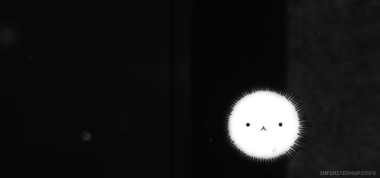
THE DOUBLE SLIT EXPERIMENT
a particle

Slide 6
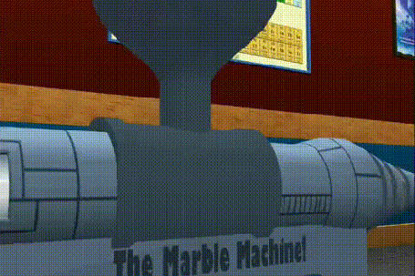
THE DOUBLE SLIT EXPERIMENT
i. Shoot a marble randomly
ii. Single slit pattern

Slide 7
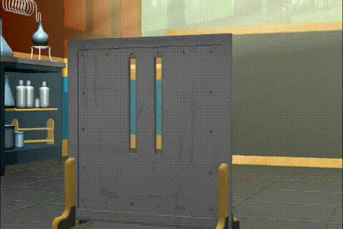
THE DOUBLE SLIT EXPERIMENT
i. Adding parallel slit
ii. Double slit pattern

Slide 8
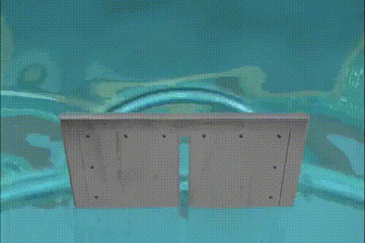
THE DOUBLE SLIT EXPERIMENT
i. Wave flows through single slit
ii. Brightest area = most intensity

Slide 9
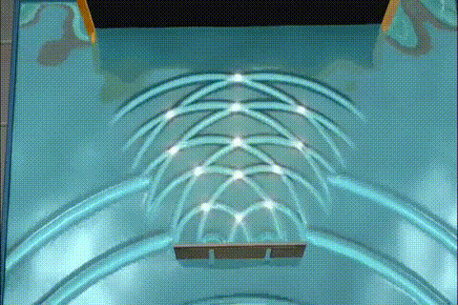
THE DOUBLE SLIT EXPERIMENT
i. Double slit situation
ii. Interference
iii. Multiple intensities

Slide 10
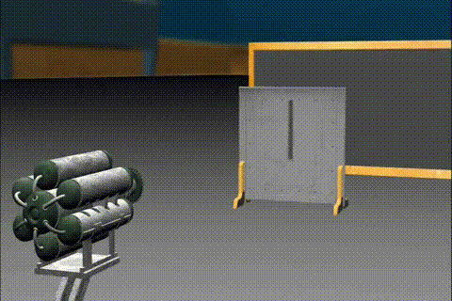

THE DOUBLE SLIT EXPERIMENT
i. Single slit with electron
ii. Same as the marble
Quick quiz: What will happen if we add another parallel slit?

Slide 11
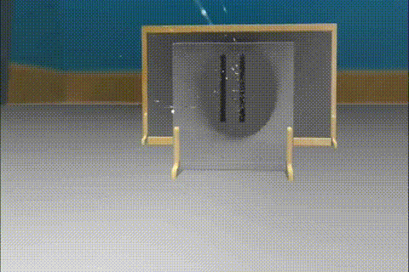

THE DOUBLE SLIT EXPERIMENT
i. Add another parallel slit
ii. Same as the wave pattern!
iii. How?

Slide 12
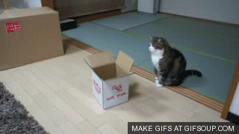
Superposition
i. Multiple states at the same time
ii. Dual split experiment explained
iii. Recall : “the cat in the box”?

Slide 13
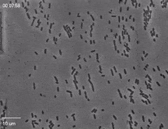
REAL WORLD APPLICATION
Electron Microscopy
- Better than light microscope
- Superposition of electron
E.coli
Other real world application of Quantum Theory
- MRI Scanner
- Lasers

Slide 14
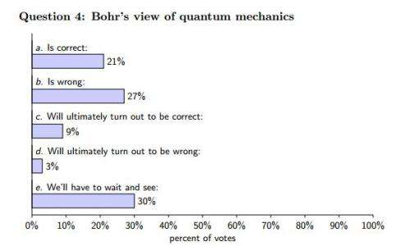
CONCLUSION
OPINIONS
Physicists votes regarding how quantum physics work
THOUGHTS??

Slide 15
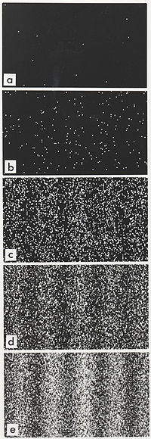
BONUS SECTION!
…. continuing from the Double Slit Experiment
Slowly shoot the electron one by one..

Slide 16
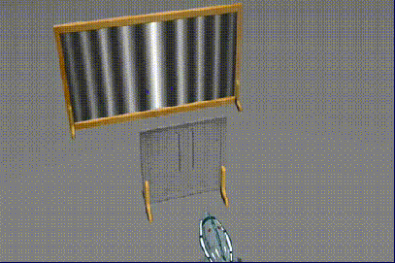
In Quantum , there are much more possibilities..
Both slits = blue
Neither = yellow
Left slit = red
Right slit = green
All of them are in superpostion with each other!...

Slide 17
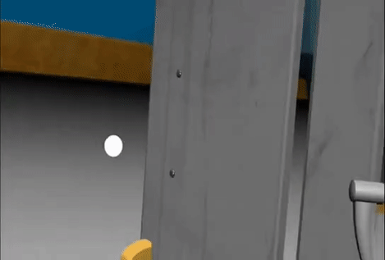
Add an observer, measuring device...
Same as the marble? !!
How????

Slide 18
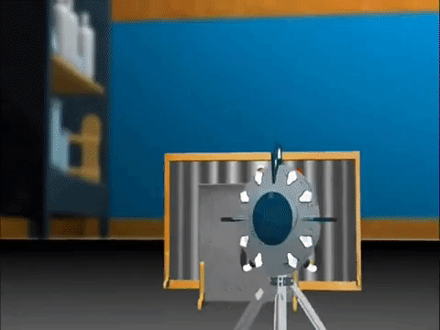
We have reached the limit of our level of understanding quantum events..
What does an observer have to do with any of these??

Slide 19
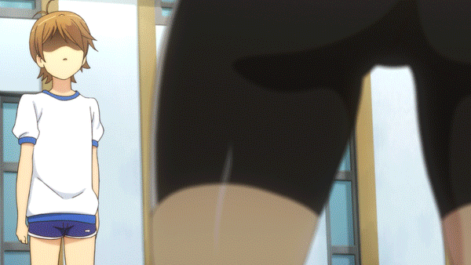
THANK YOU FOR YOUR ATTENTION

